Slide 1
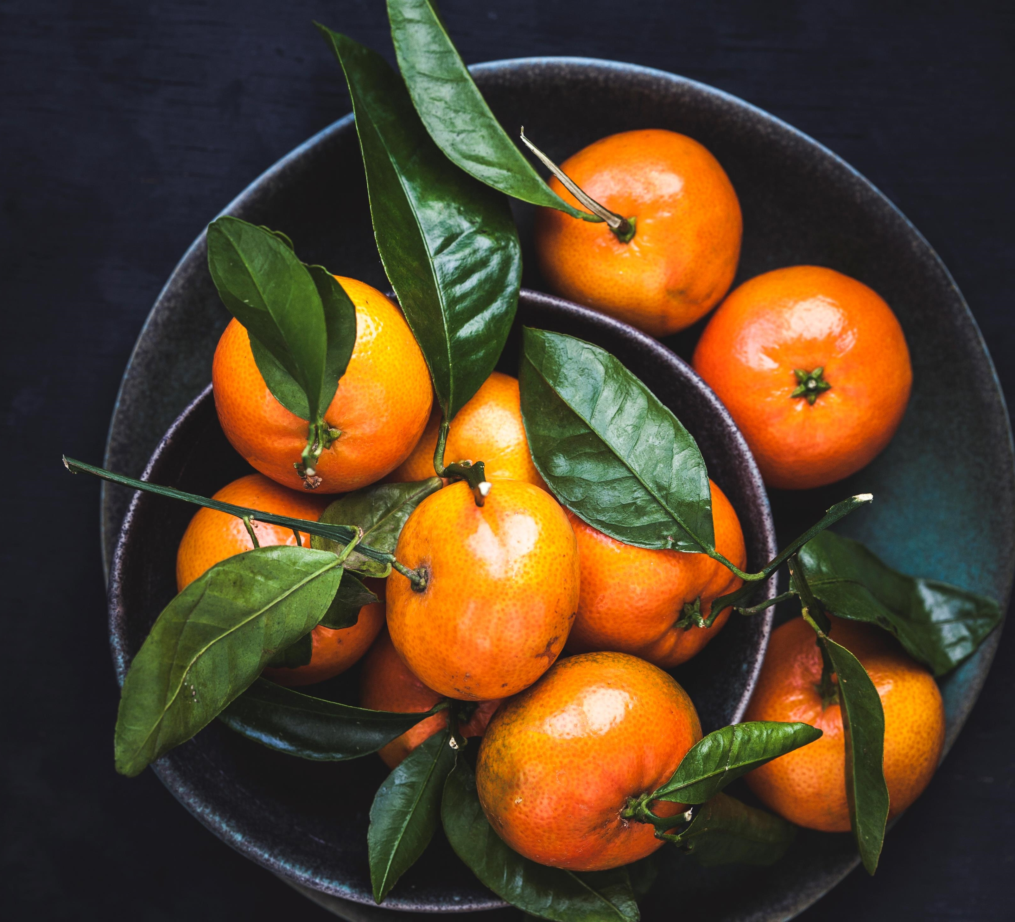
FIVE ACES
Community Gardens
And
High School Graduation Rates
Notes:
Welcome! For our second project, the Five Aces, wanted to pick up where we left off in project one, as to how nutrition affects educational performance. For this project, we selected Atlanta and New York City to compare the number of community gardens and the number of high school graduates.

Slide 2
Members
Johnny Bowers
Terri Lively
Akadia Kacha-Ochana
Daniel Ramirez
Luis Solorzano

Slide 3
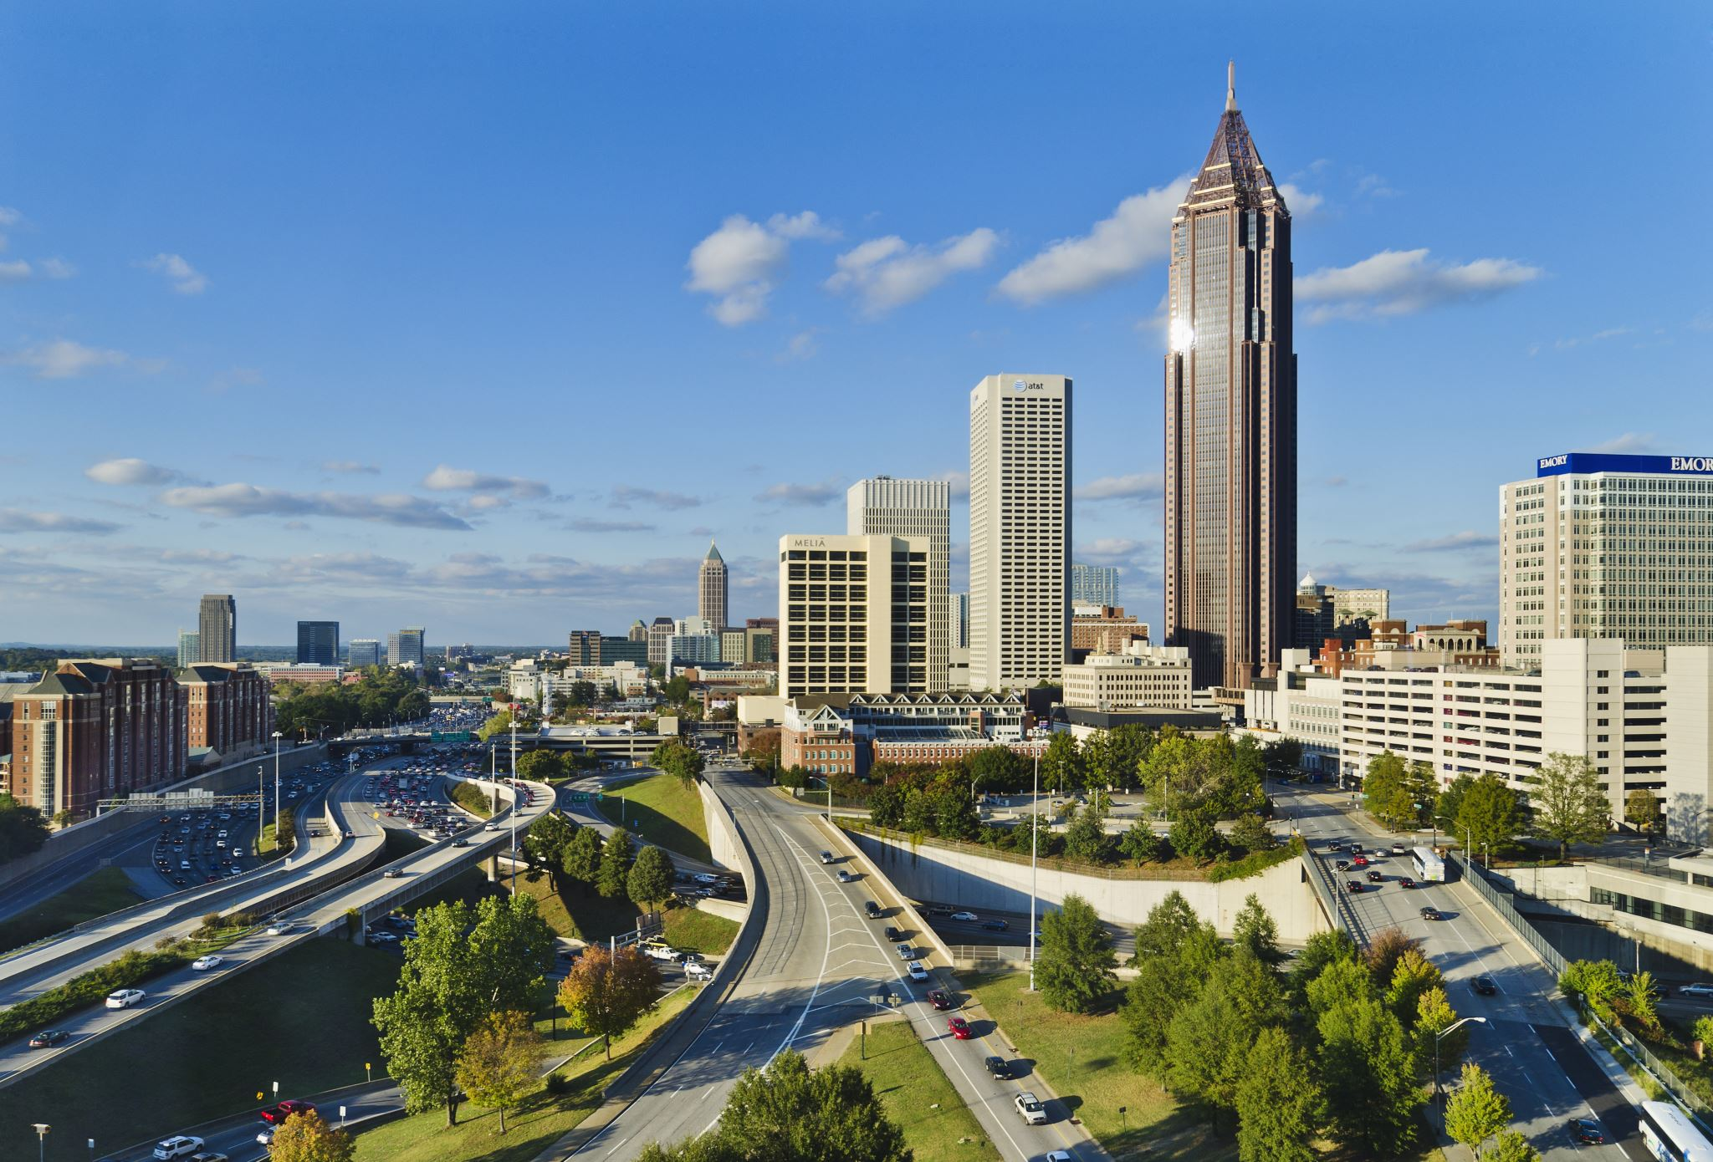

Why Atlanta and NYC?
Notes:
You’re probably wondering why Atlanta and NYC? We chose them for personal reasons, one of our members has lived in both areas. NYC is known for being a concrete jungle where Atlanta has more green space. And here, we will be comparing Apples to Peaches!

Slide 4
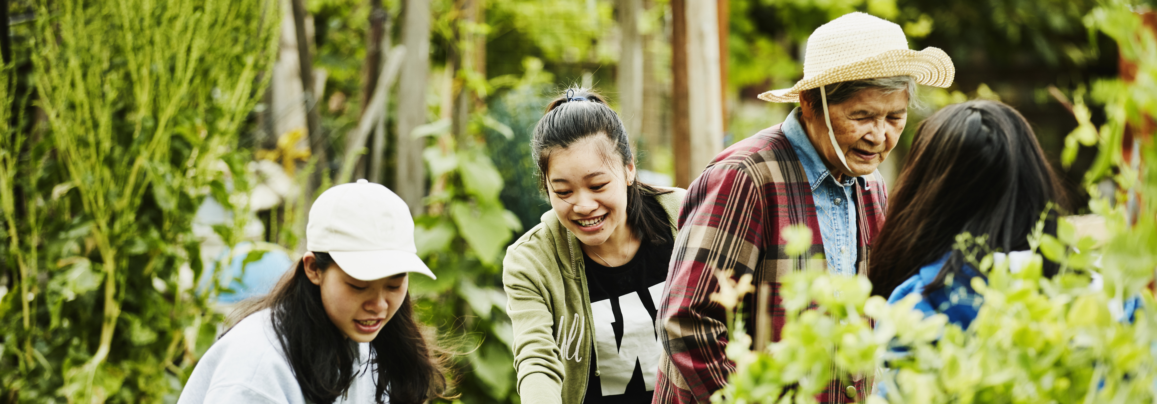
Benefits of Community Gardening
Community Organization
Education
Crime Prevention
Cultural Opportunities
Environmental Sustainability
Healthier Diets
Notes:
Community gardens increase a sense of community ownership and stewardship.
They bring people of all backgrounds, ages, races, cultures and social classes together
Studies show that community gardeners and their children eat healthier diets than non-gardening families do.

Slide 5

Helps Environmental Sustainability
Filters Rainwater
Restores Oxygen
Recycles Organic Waste
Notes:
It filters rainwater, helping to keep lakes, rivers and groundwater clean.
Restores oxygen to the air helping to reduce pollution.
Recycle huge volumes of organic waste back into the soil.

Slide 6
Educational Benefits
Opportunity to Teach Youth
How to grow food
Practical Math Skills
Basic Business Principles
The Importance of Community and Stewardship
Job and Life Skills
Notes:
Offers the opportunity to teach youth about: How to grow food, Practical Math Skills, Basic Business Principles, the importance of community and stewardship, along with Job and Life Skills.

Slide 7
FIVE ACES
NOW FOR OUR LIVE DEMO
Notes:
Now for our live demo . . . .

Slide 8
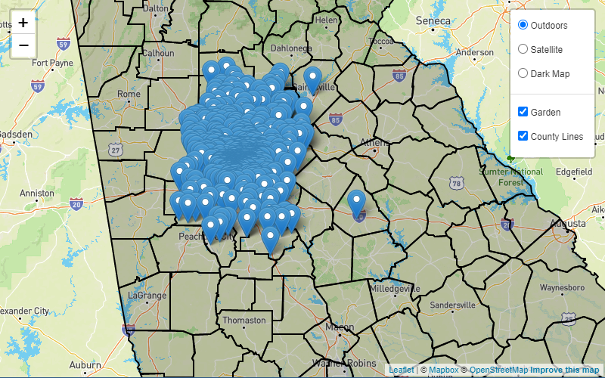
Gardens in the Atlanta Area

Slide 9
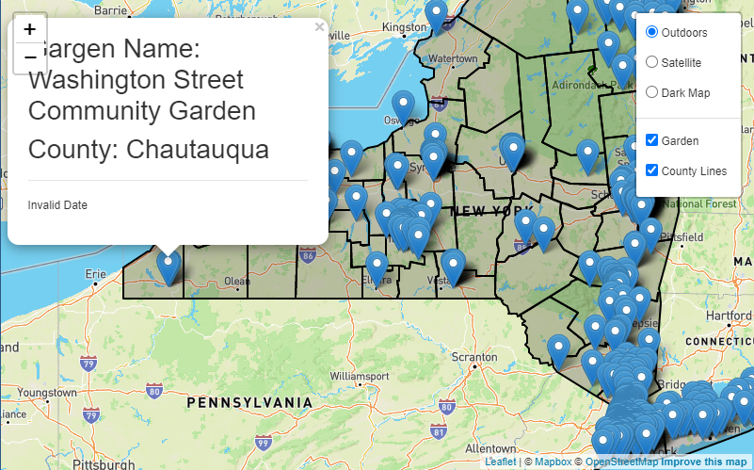
Garden Name:
Washington Street

Slide 10
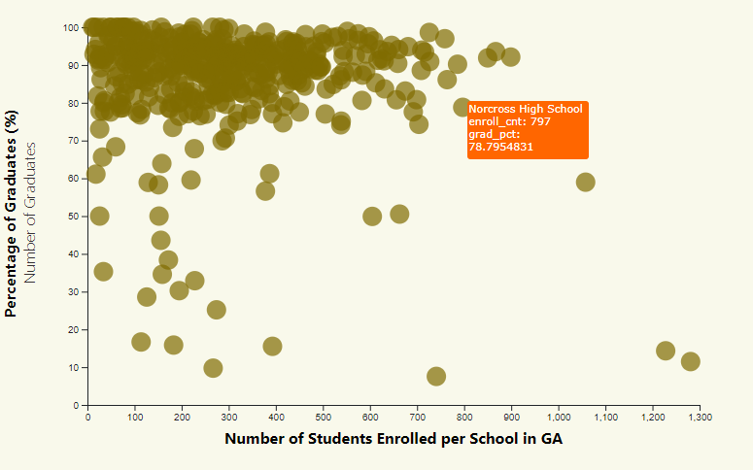
Georgia Graduation Rates

Slide 11
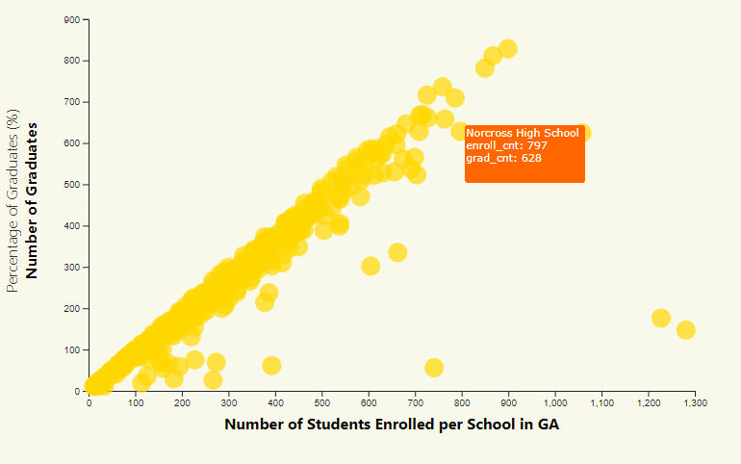
Graduation Counts in GA

Slide 12
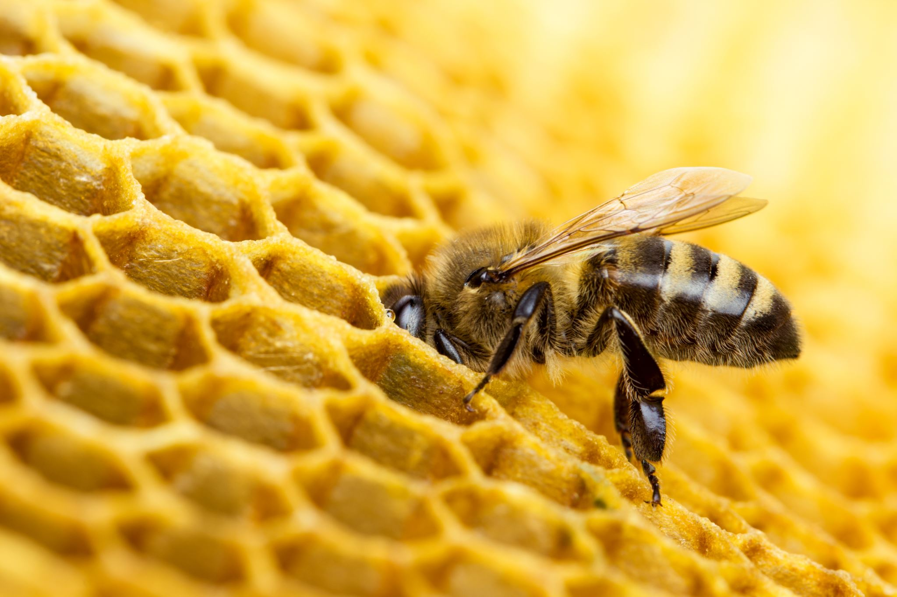
What’s Next . . .
Daniel’s Gardening 101
UGA MASTER GARDENER’S PROGRAM – become part of your local gardening community
GEOBIN COMPOSTER – Use you fall leaves to make soil
SUBPOD – The best worm composting – No smells or rodents
GREENSTALK – Maximize small spaces and grow you own food and flowers
NO-TILL GARDENING – using cardboard/pine/leaves
FLOWHIVE – allows you to harvest honey
COMPOST NOW – Service to use your scraps to make soil
Notes:
Thank you for your time and we hope that the garden bug has bitten you and you’d like to get started with your own garden, here are just a few resources. Feel free to contact any of our team members for more information on these resources.

Slide 13
FIVE ACES
Johnny Bowers
Terri Lively
Akadia Kacha-Ochana
Daniel Ramirez
Luis Solorzano

